Slide 1
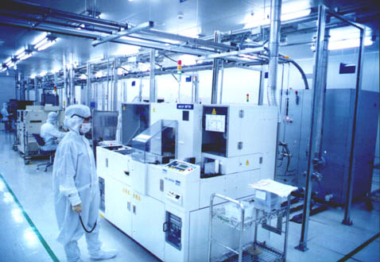

Applications for FTIR Testing for Semiconductor Facilities
Strengths & Limitations
T. Higgs
May 25, 2017
AESA Stack Testing Seminar
1

Slide 2
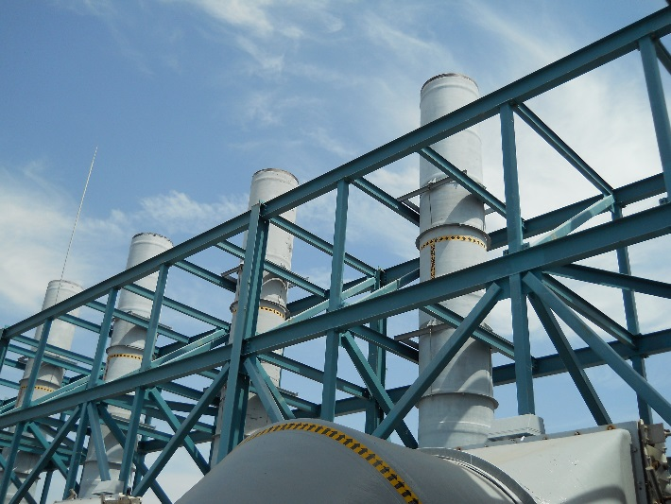
Potential Applications
FTIR testing widely used in semiconductor industry
  Centralized abatement system testing
    Performance efficiency testing, quantifying total mass emissions
      Scrubber systems
      Thermal oxidizers/VOC abatement
  Fab process tool characterization
    Plasma tools on etch/CVD operations
    Lithography tools
  Point of use abatement device performance
2

Slide 3
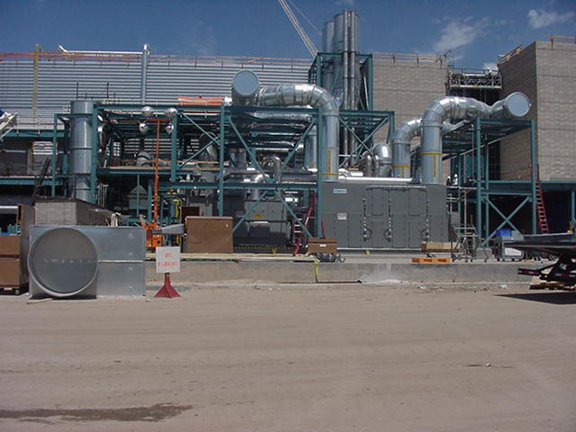
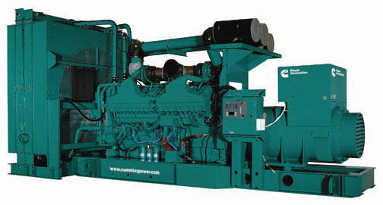
Pollutants of Interest
Semiconductor fabs have diverse mix of pollutant types
  Hazardous Air Pollutants (HAPs)
    Hydrofluoric Acid (HF), Hydrochloric Acid (HCl), Chlorine (Cl2)
  Volatile Organic Compounds (VOCs)
    Speciation of individual organics sometimes desired (e.g. organic HAPs)
  Greenhouse gases
    Fluorinated gases (e.g. NF3, CF4, SF6)
    Nitrous oxide (N2O)
  Combustion sources (CO, NOx)
3

Slide 4
Semiconductor Emissions Characteristics
Semiconductor fab emissions characterized by:
  Large number of individual emission generating units
    Hundreds of individual fab tools, connected to common exhaust systems
      Some tools emit multiple pollutants, pollutant types
Separate exhaust systems - VOCs, acids, ammonia/bases
Complex mix of pollutants in some exhaust systems
  High flow, relatively low concentration
FTIR a good fit for fab emissions measurement
  Capable of measuring wide range of pollutants
  Low detection limits achievable on many
4

Slide 5

Exhaust System Layout
Fab tools connecting into common main duct which branches off to several units
5

Slide 6
Proper Uses, Limitations for FTIR in SC Industry
FTIR ideal for many testing needs - must understand limits, uncertainties
  Cl2, F2 emissions common in industry; not measurable by FTIR
  Detection limits vary by compound, conditions
    ND readings can have material impact on results in high flow systems
  VOC abatement efficiency best measured by total hydrocarbon method
  Emissions variability important if using short term test to quantify longer term emissions
    e.g. monthly, annual
Interferences between compounds in complex exhaust stream
  High level of FTIR expertise needed to ensure quality results
6

Slide 7
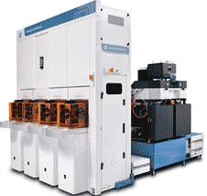
Process Tool Emissions Testing
Emissions out; may be
HAPs (e.g. HF)
GHGs (e.g. CF4, NF3)
VOCs
Chemicals, gases in
Typical flow rates may be 10 – 100 liters/minute
Pollutant concentrations often > 100 ppm
On any given tool, known list of possible pollutants is relatively small
FTIR widely used for quantifying fab tool emissions
  Often compared to chemical use to understand use/emissions relationship and scale results to more tools, longer time periods
7

Slide 8
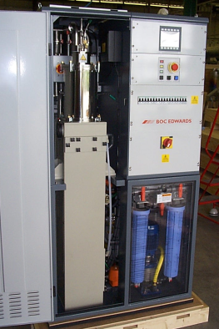
Point of use device testing
Fab Tool Emissions in
Relatively high concentration, low flow
Short list of known pollutants
Many emissions reduced >95%
Others converted to different materials, then treated
  E.g. CF4, NF3 HF
Simultaneous FTIR inlet/outlet testing often used to measure device removal efficiency
8

Slide 9
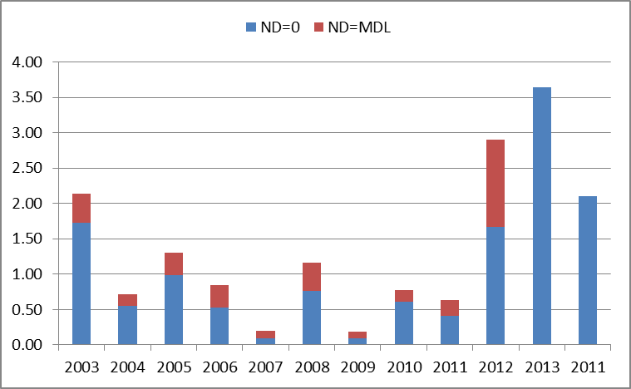
Quantifying annual HF Emissions from Scrubber Stacks
Data from 2 fab sites over many years
Detection limits typically 100 – 200 ppb
Individual stack concentrations range from ND to ~1ppm
8 hr. test period; results scaled to estimate annual emissions
Total system flows range from 300-800k cfm
tpy
In this application, non-detect readings can be a source of uncertainty in results
9

Slide 10
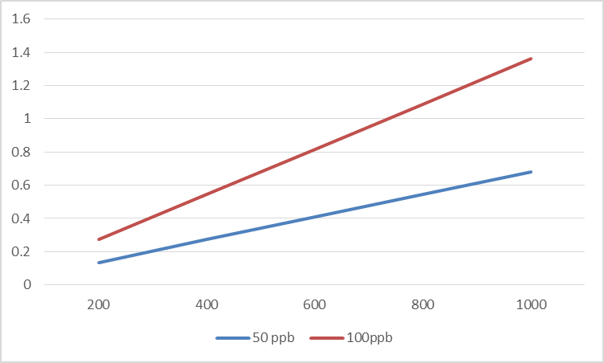
Error in Total Mass Determination at Various Flows
In high flow exhaust systems detection limit can significantly impact overall error in total mass emissions calculation
Max uncertainty introduced at different flow rates and detection limits
Tpy HF
Scrubber flow, kcfm
10

Slide 11
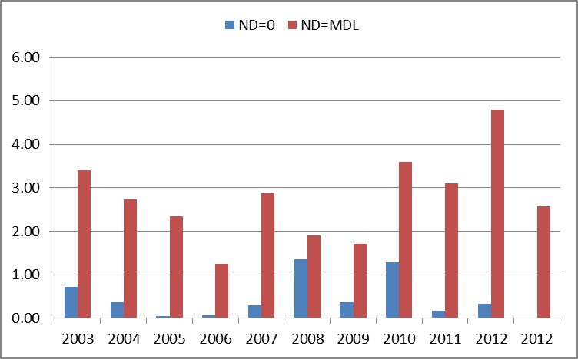
Quantifying annual HCl Emissions from Scrubber Stacks
Data from 2 fab sites over many years
Detection limits 400 – 500 ppb
Individual stack concentrations range from ND to ~600ppb
  Most stacks ND
8 hr. test period; results scaled to estimate annual emissions
Total system flows 300-800k cfm
tpy
In this application, non-detect readings introduce a large uncertainty – high detection limits, most readings non-detect
11

Slide 12
Quantifying annual GHG Emissions from Scrubber Stacks
Site w/30 scrubber stacks
  Combined flow 534,000 cfm
7 PFCs/HFCs monitored, 8 hrs./stack
 | Lb./hr at 0 | Lbs./hr at MDL | Annual mtCO2e at 0 | Annual mtCO2e at MDL
CF4 | 1.52 | 1.53 | 44,652 | 45,033
CH3F | 0.08 | 0.25 | 31 | 96
CH2F2 | 0.13 | 0.35 | 354 | 926
C2F6 | 1.71 | 2.28 | 82,878 | 110,521
SF6 | 0.52 | 0.67 | 46,901 | 61,077
CHF3 | 0.08 | 0.11 | 4830 | 6701
NF3 | 0.45 | 0.75 | 30,983 | 38,959
Total |  |  | 210,629 | 263,313
Material | Det Limit, ppb | % of readings below det. limit
CF4 | 3 | 43.7
CH3F | 64 | 91.3
CH2F2 | 56 | 88.1
C2F6 | 44 | 63.6
SF6 | 6 | 49.2
CHF3 | 6 | 74.8
NF3 | 29 | 70.5
Average: 236,971 mtCO2
Error range: +/- 26,342 (11%)
12

Slide 13
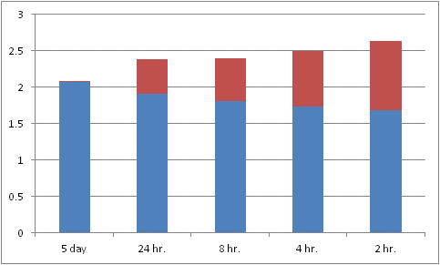
Impact of Sampling Times
Emissions fluctuate over time, impact scaling of short term results to longer term estimate
Group of scrubber stacks monitored for 5 days
Max and min HF results calculated from various time periods
Based on 95% CI around average measured value
Conclusion: Scaling results over short test periods can introduce significant error
8 hr. test period only introduces variability of +/- 0.3 tpy compared to 5 day
HF Tpy
13

Slide 14
VOC Abatement System Testing
Total removal efficiency testing best done with total hydrocarbon method
  Typical outlet concentration <2ppm THC
    Much of that is methane
    Individual organics a subset of what remains; quantifying individual species difficult
    10 years of quarterly FTIR VOC outlet data
      10 organics, almost all readings ND; occasional detections of methanol, ethanol, IPA
  Speciated methods (e.g. FTIR) may be useful for troubleshooting system performance issues
    Identifying which compounds are poorly removed
Methanol | Ethanol | IPA | m-xylene | o-xylene | p-xylene | Ethyl Lactate | PGMEA | NBUAC | HMDS
CONCENTRATION
(ppm) | (ppm) | (ppm) | (ppm) | (ppm) | (ppm) | (ppm) | (ppm) | (ppm) | (ppm)
ND | ND | ND | ND | ND | ND | ND | ND | ND | ND
ND | ND | ND | ND | ND | ND | ND | ND | ND | ND
ND | ND | ND | ND | ND | ND | ND | ND | ND | ND
14

Slide 15
Summary
Semiconductor manufacturing emissions are complex and highly variable
  Wide range of different pollutants, many contributing sources
  Often dilute at final emission point; relatively high concentration at source
Stack testing has multiple purposes
  Abatement device removal efficiency
  Characterizing emissions from individual process steps
  Determining plant wide mass emissions
    By individual chemical, or group of chemicals (e.g. total hydrocarbons)
FTIR is powerful tool for complex emissions with wide range of chemicals
  Important to understand both strengths and limits on ability to draw conclusions
15

